Slide 2
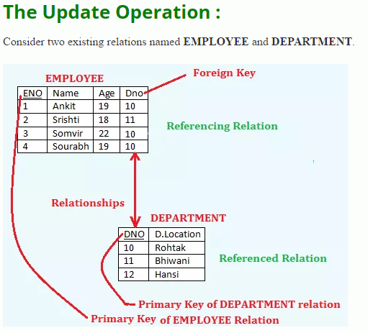
Update Operations and Dealing with Constraint Violations –

Slide 3
Here, ENO is a Primary Key and DNO is a Foreign Key in EMPLOYEE relation.
Table that contain candidate key is called referenced relation and
The table containing foreign key is called referencing relation.
So, the relation DEPARTMENT is a referenced relation and
The relation EMPLOYEE is a referencing relation.
The update operation violates only referential Integrity Constraints or Integrity Rule 2.

Slide 4
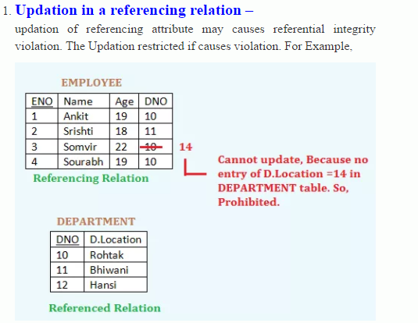

Slide 5
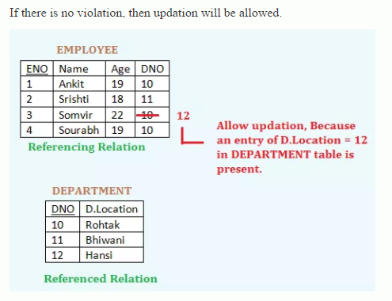

Slide 6
Updation in a referenced relation –
There are again three options available if an updation causes violation
Reject the updation – (ON UPDATE NO ACTION) – It prevents updating a parent when there are children. It is the the Default Constraint.
Cascade Updation – (ON UPDATE CASCADE) – If updation causes integrity violation, then update in both the table i.e. if the tuples are updated from the referenced table, then the tuple will also be updates from the referencing relation that is being updated.
Modify the referencing Attributes – (ON UPDATE SET NULL) – sets null value or some valid value in the foreign key field for corresponding updating referenced value. i.e. changing/updating the referencing attribute values that cause the violation either null or another valid value. If there is no restriction or constraint applied for putting the NULL value in the referencing relation – then allow to update from referenced relation otherwise prohibited.

Slide 7
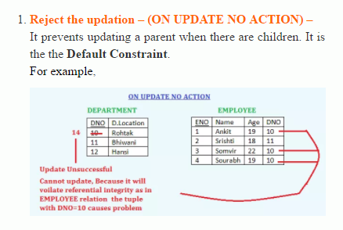

Slide 8
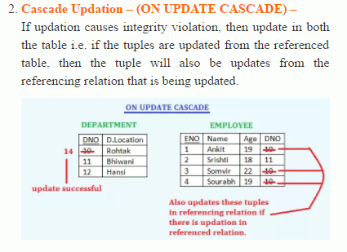

Slide 9
